Slide 1

Connect 4 / Tic-Tac-Toe Game (ConnectXO)
Connect 4 / Tic-Tac-Toe Game (ConnectXO)
Džana Kopić
Kanita Tafro

Slide 2
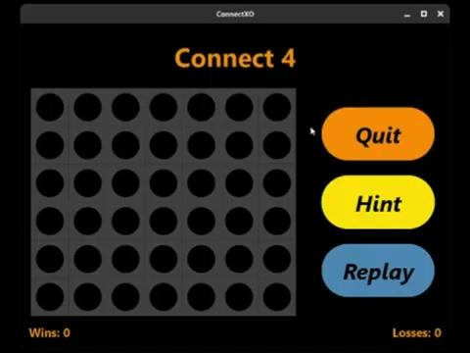

Slide 3
What powers the AI
Minimax with alpha-beta pruning
5 difficulty modes
Depth-scaling factor rather than separate algorithms
Very Easy: 30% depth
Easy: 45% depth
Medium: 65% depth
Hard: 80% depth
Very Hard: 100% depth

Slide 4
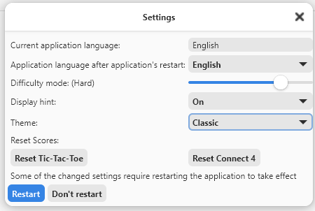
Adjustable Settings
Languages: English, Bosnian, Spanish (requires restart)
Difficulty modes
Hints
Five color themes (requires restart)
Counter reset

Slide 5
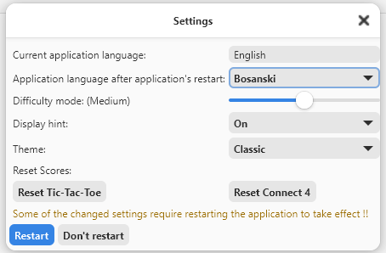
Adjustable Settings
Languages: English, Bosnian, Spanish (requires restart)

Slide 6
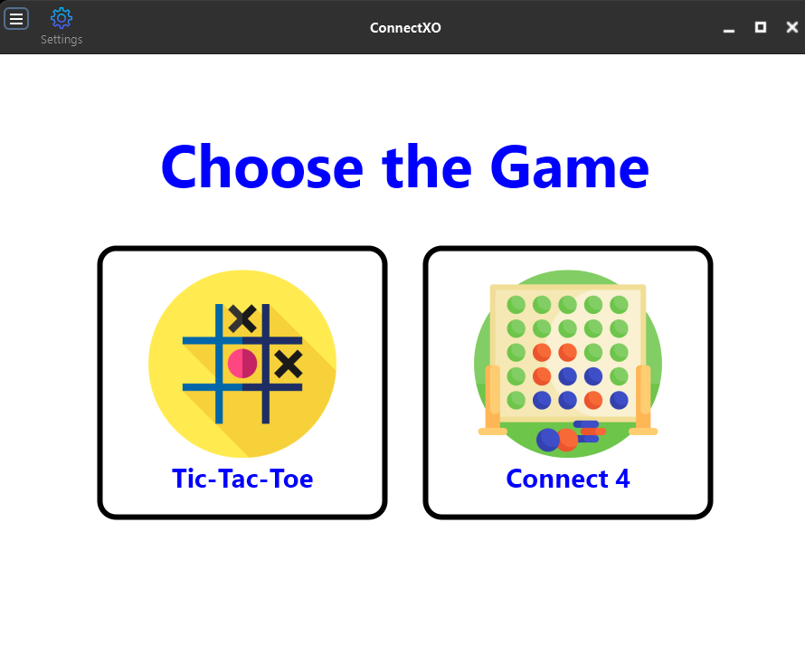
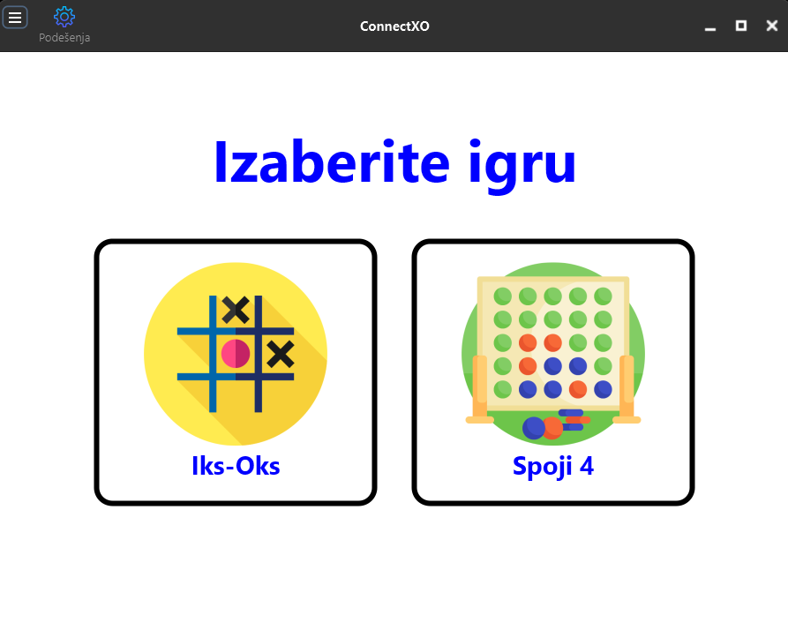
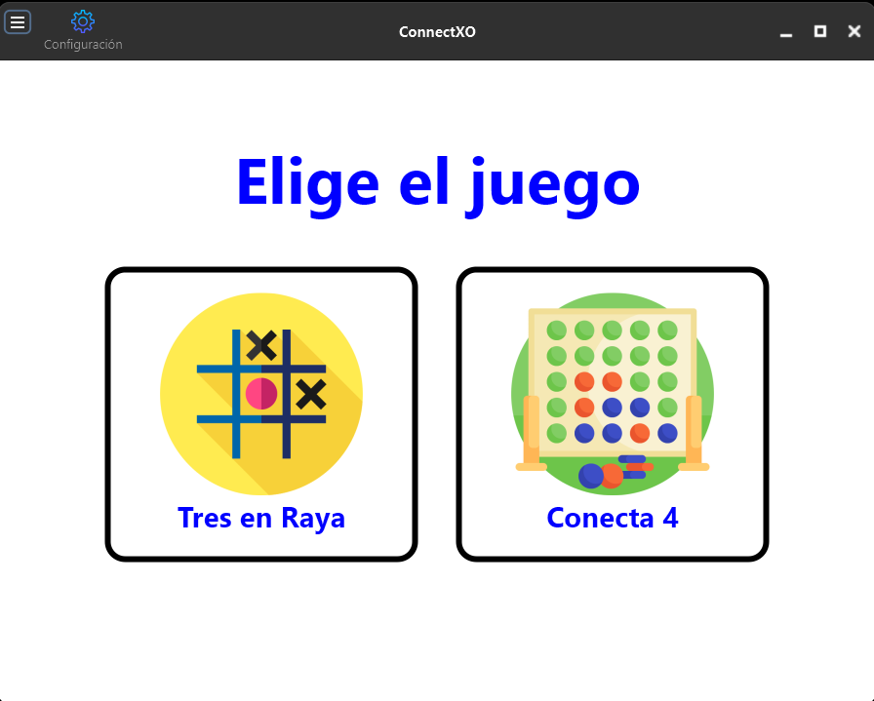
Languages
ENGLISH
BOSNIAN
SPANISH

Slide 7
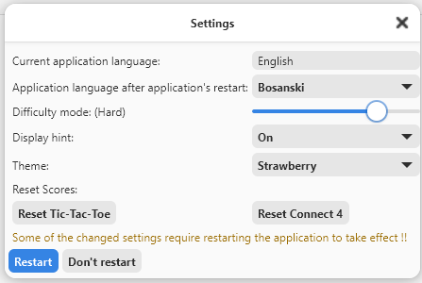
Adjustable Settings
Difficulty modes
Very Easy: 30% depth
Easy: 45% depth
Medium: 65% depth
Hard: 80% depth
Very Hard: 100% depth

Slide 8
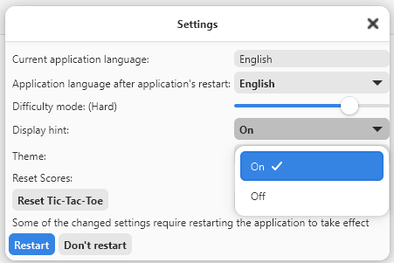
Adjustable Settings
Hints

Slide 9
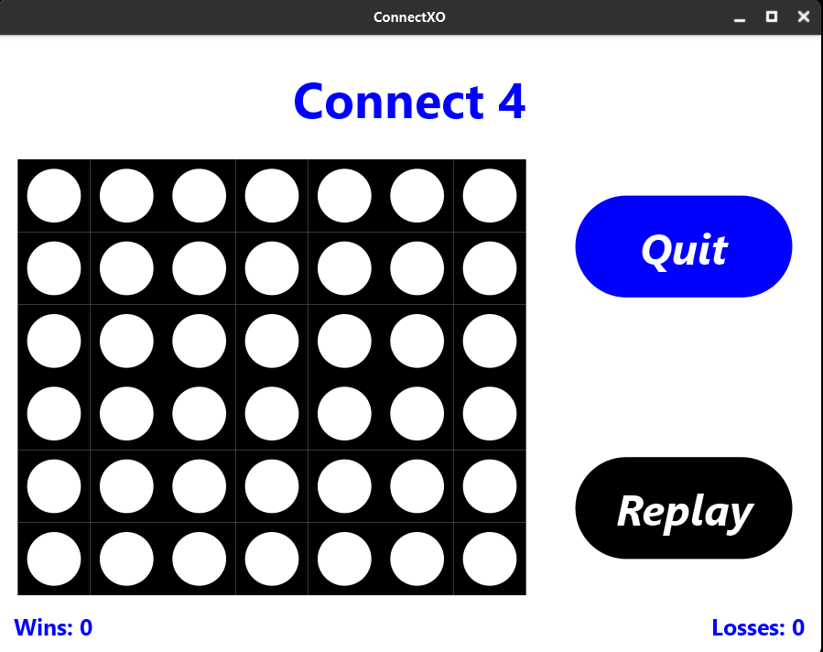
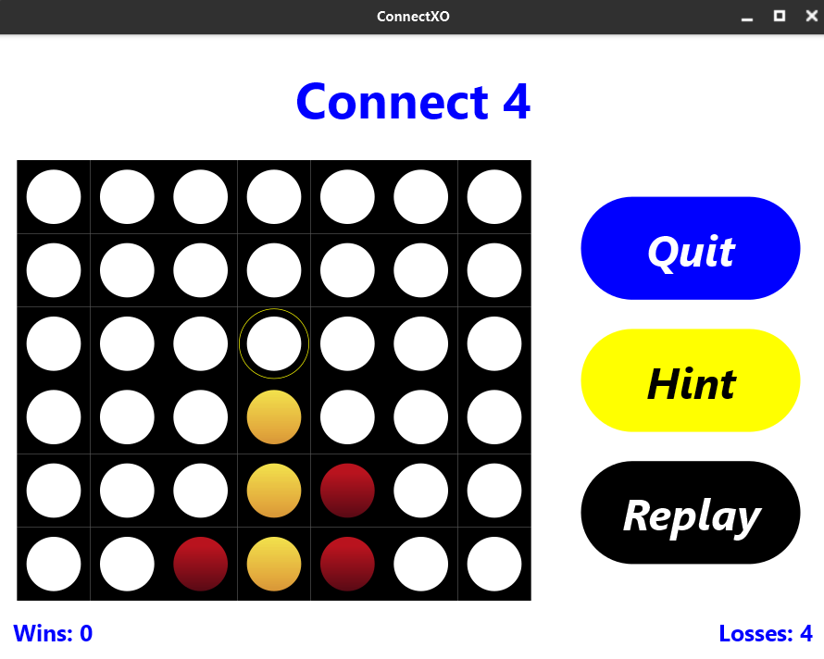
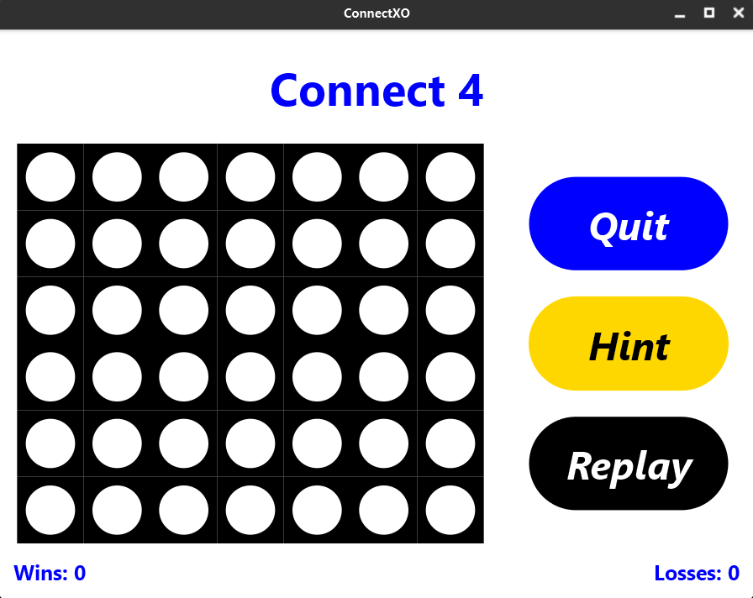
Hints

Slide 10
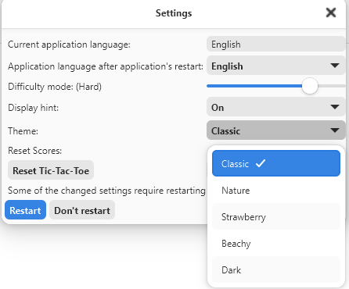
Adjustable Settings
Five color themes (requires restart)

Slide 11
Color themes

Slide 12
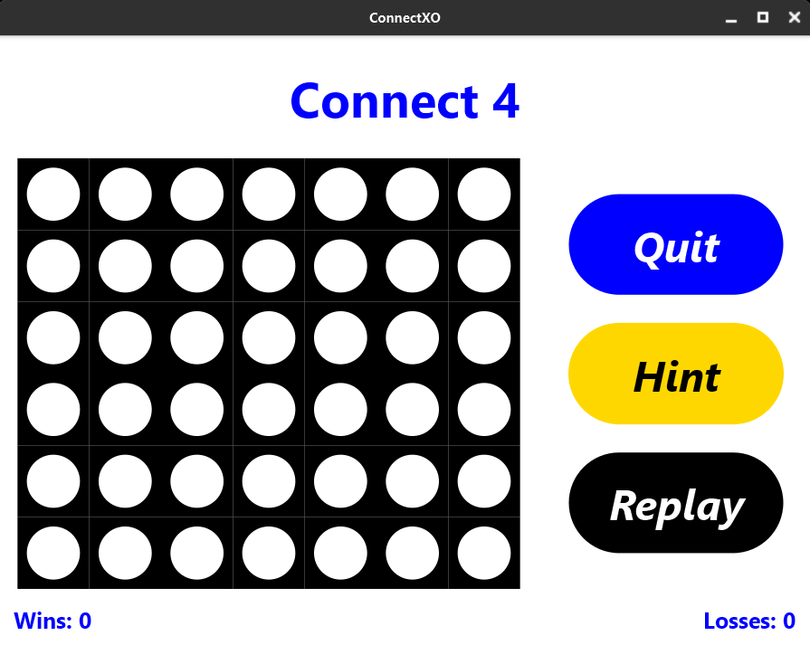

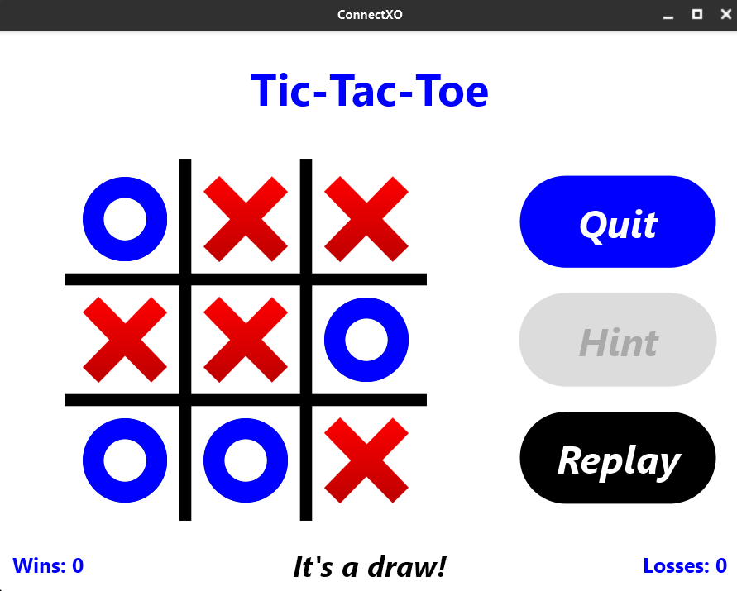
Classic theme

Slide 13
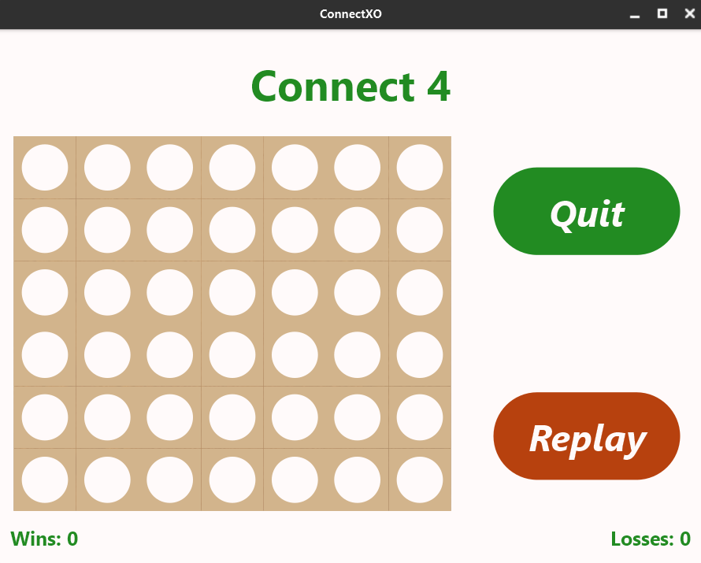
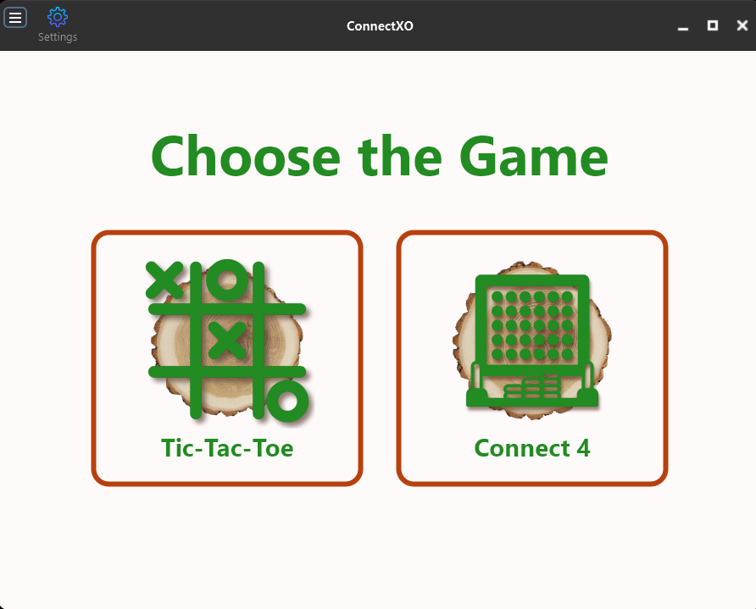
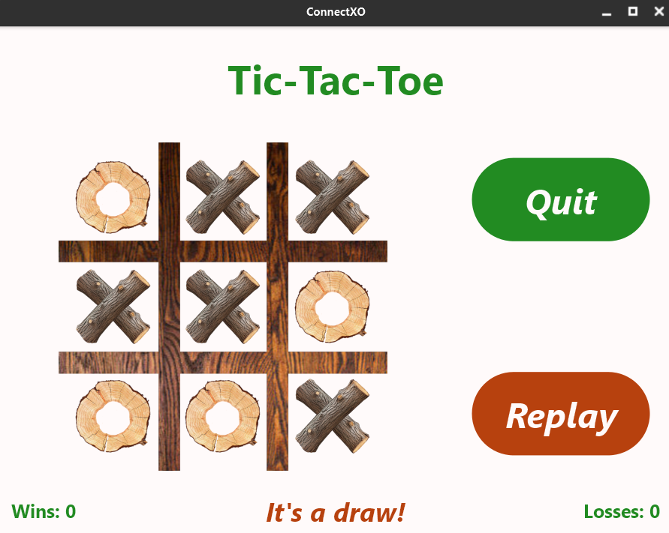
Nature theme

Slide 14
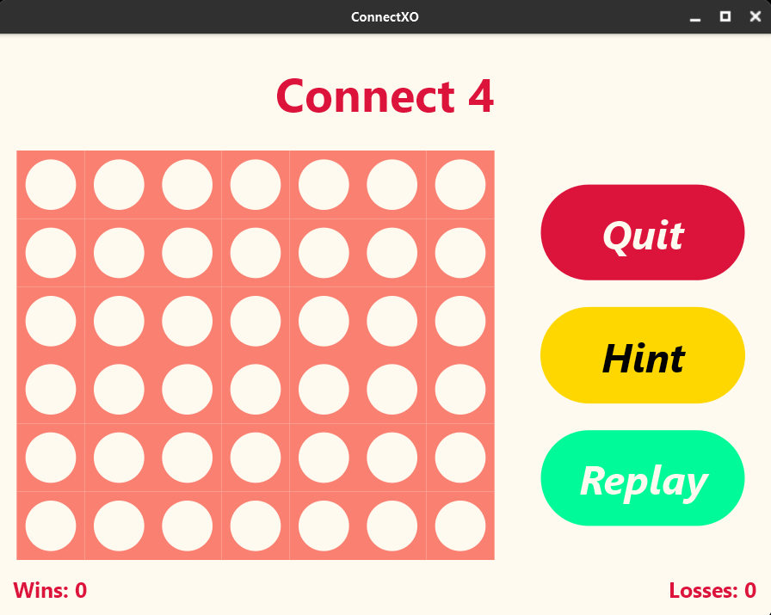
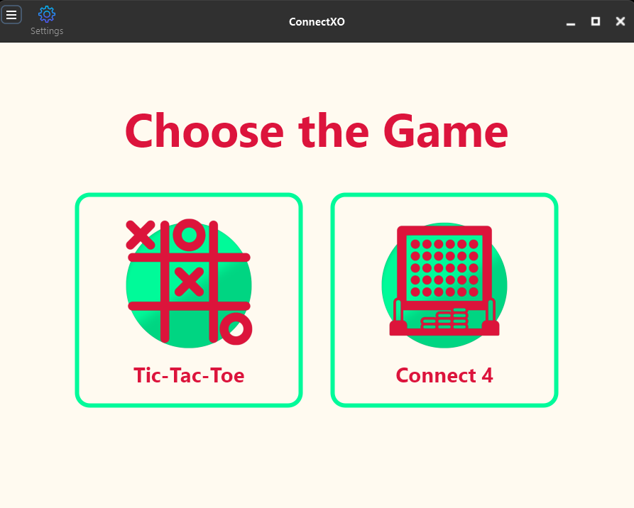
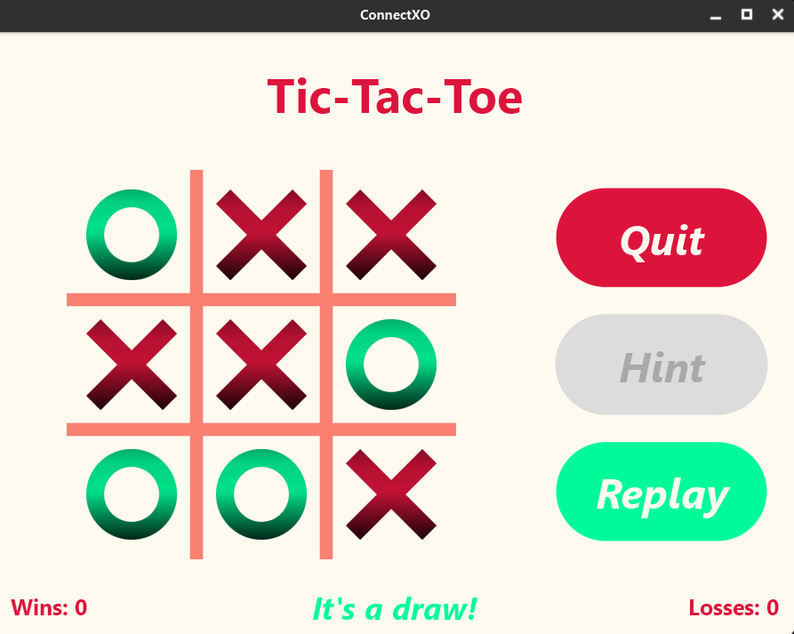
Strawberry theme

Slide 15
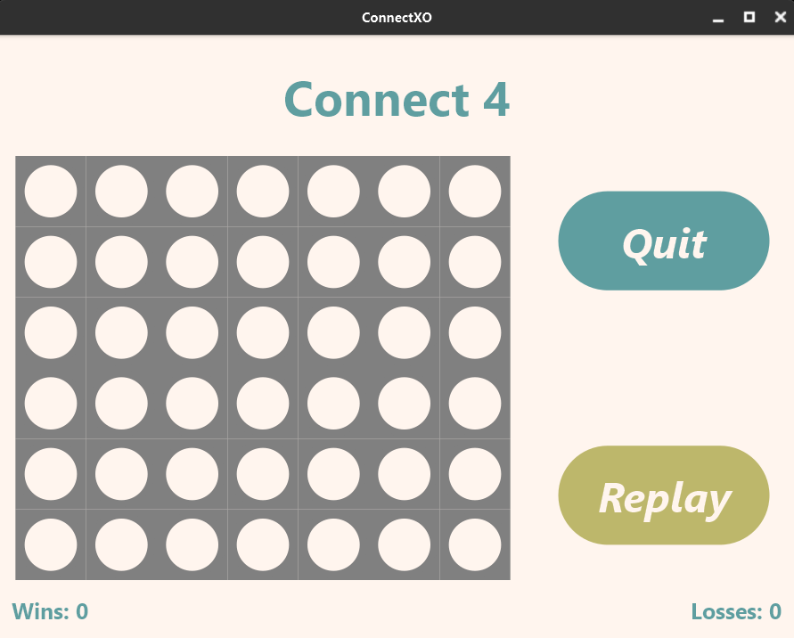
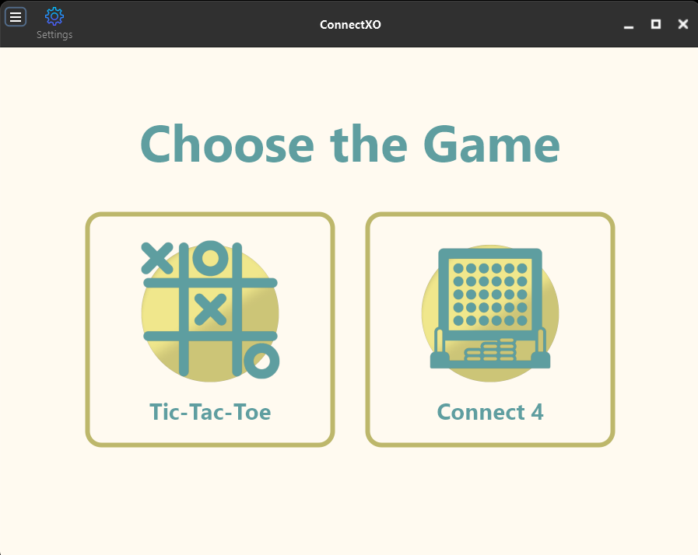
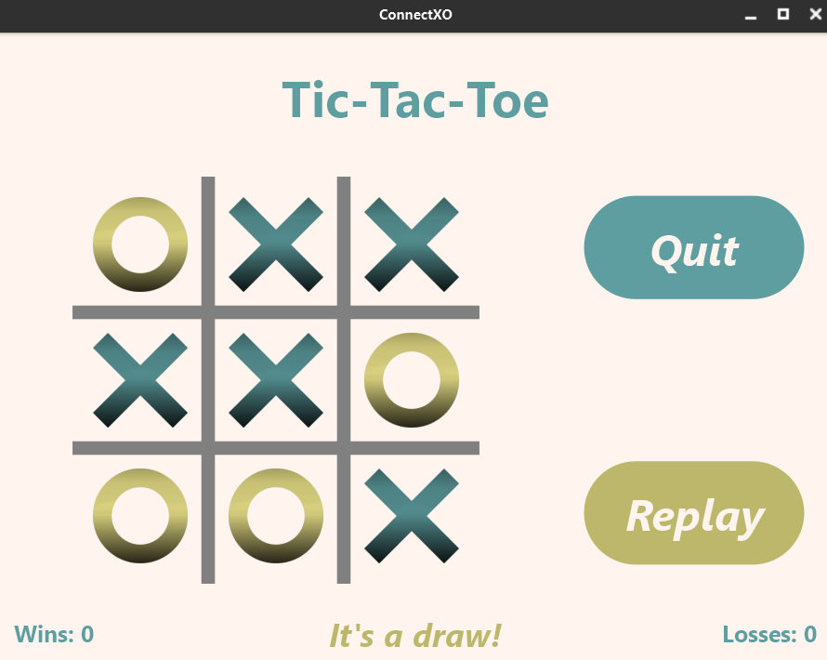
Beachy theme

Slide 16
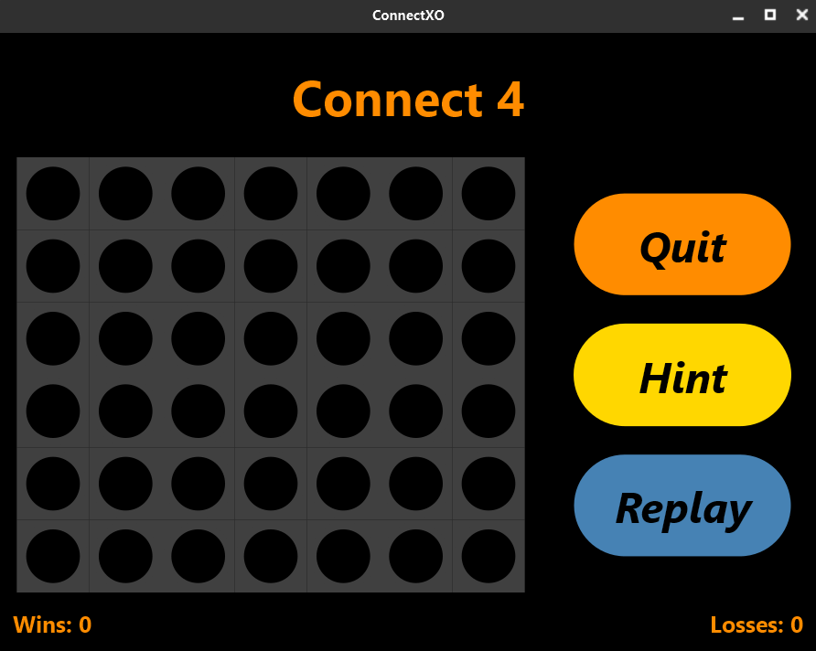
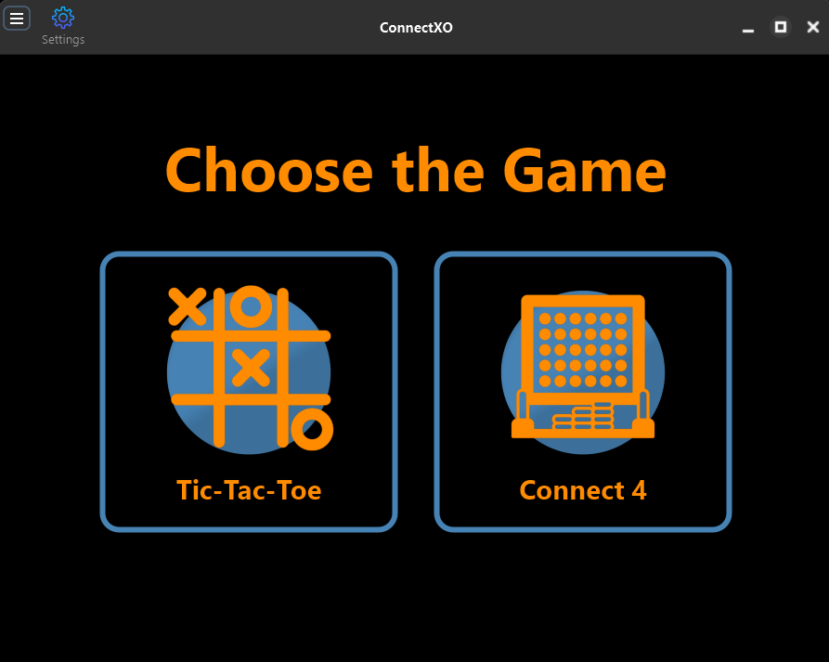
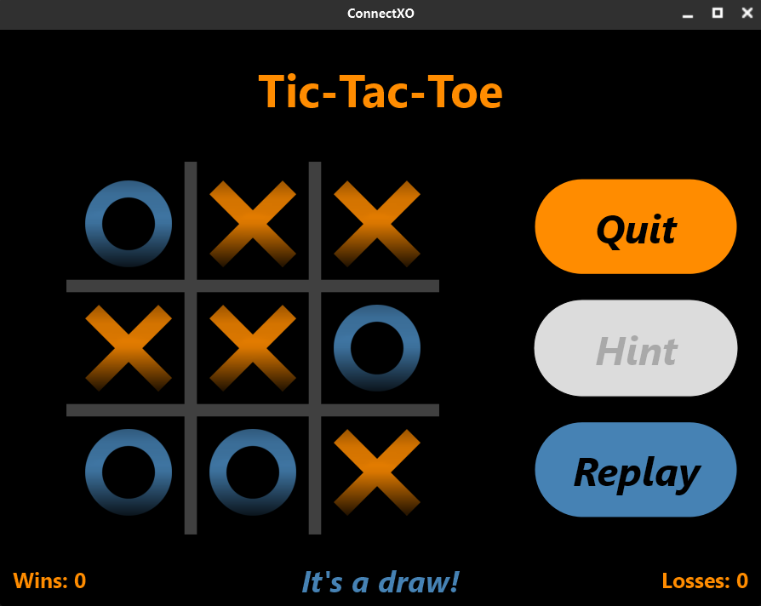
Dark theme

Slide 17
APP DEMO
APP DEMO

